Slide 1
The role of Venice Calls before, during, and after 2019 Acqua Alta
Speaker: Sebastiano Cognolato | Co-founder and President of Venice Calls
SHELTER Conference – 28th April 2023, Palazzo Zorzi (Venice)

Slide 5
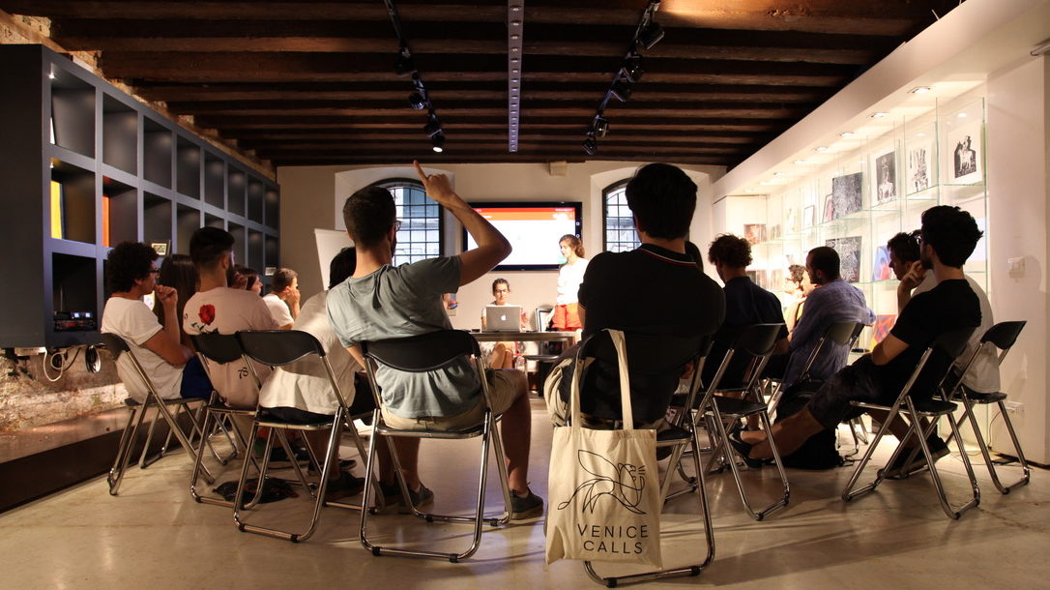
HOW IT STARTED
our first activities

Slide 6
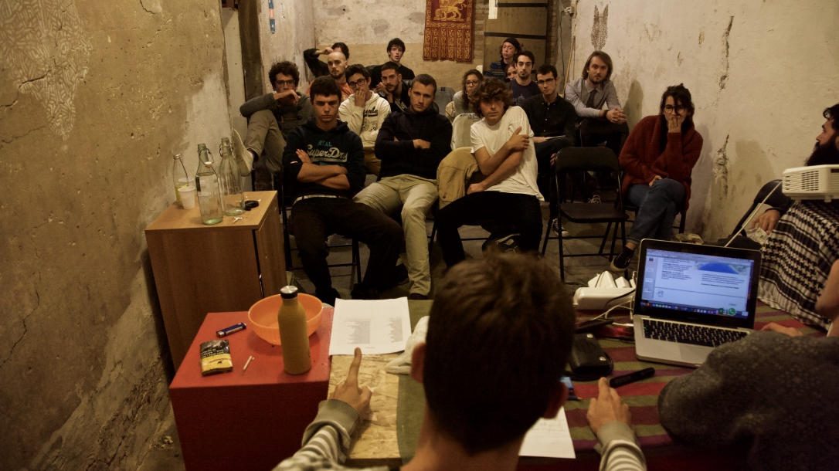

Slide 7
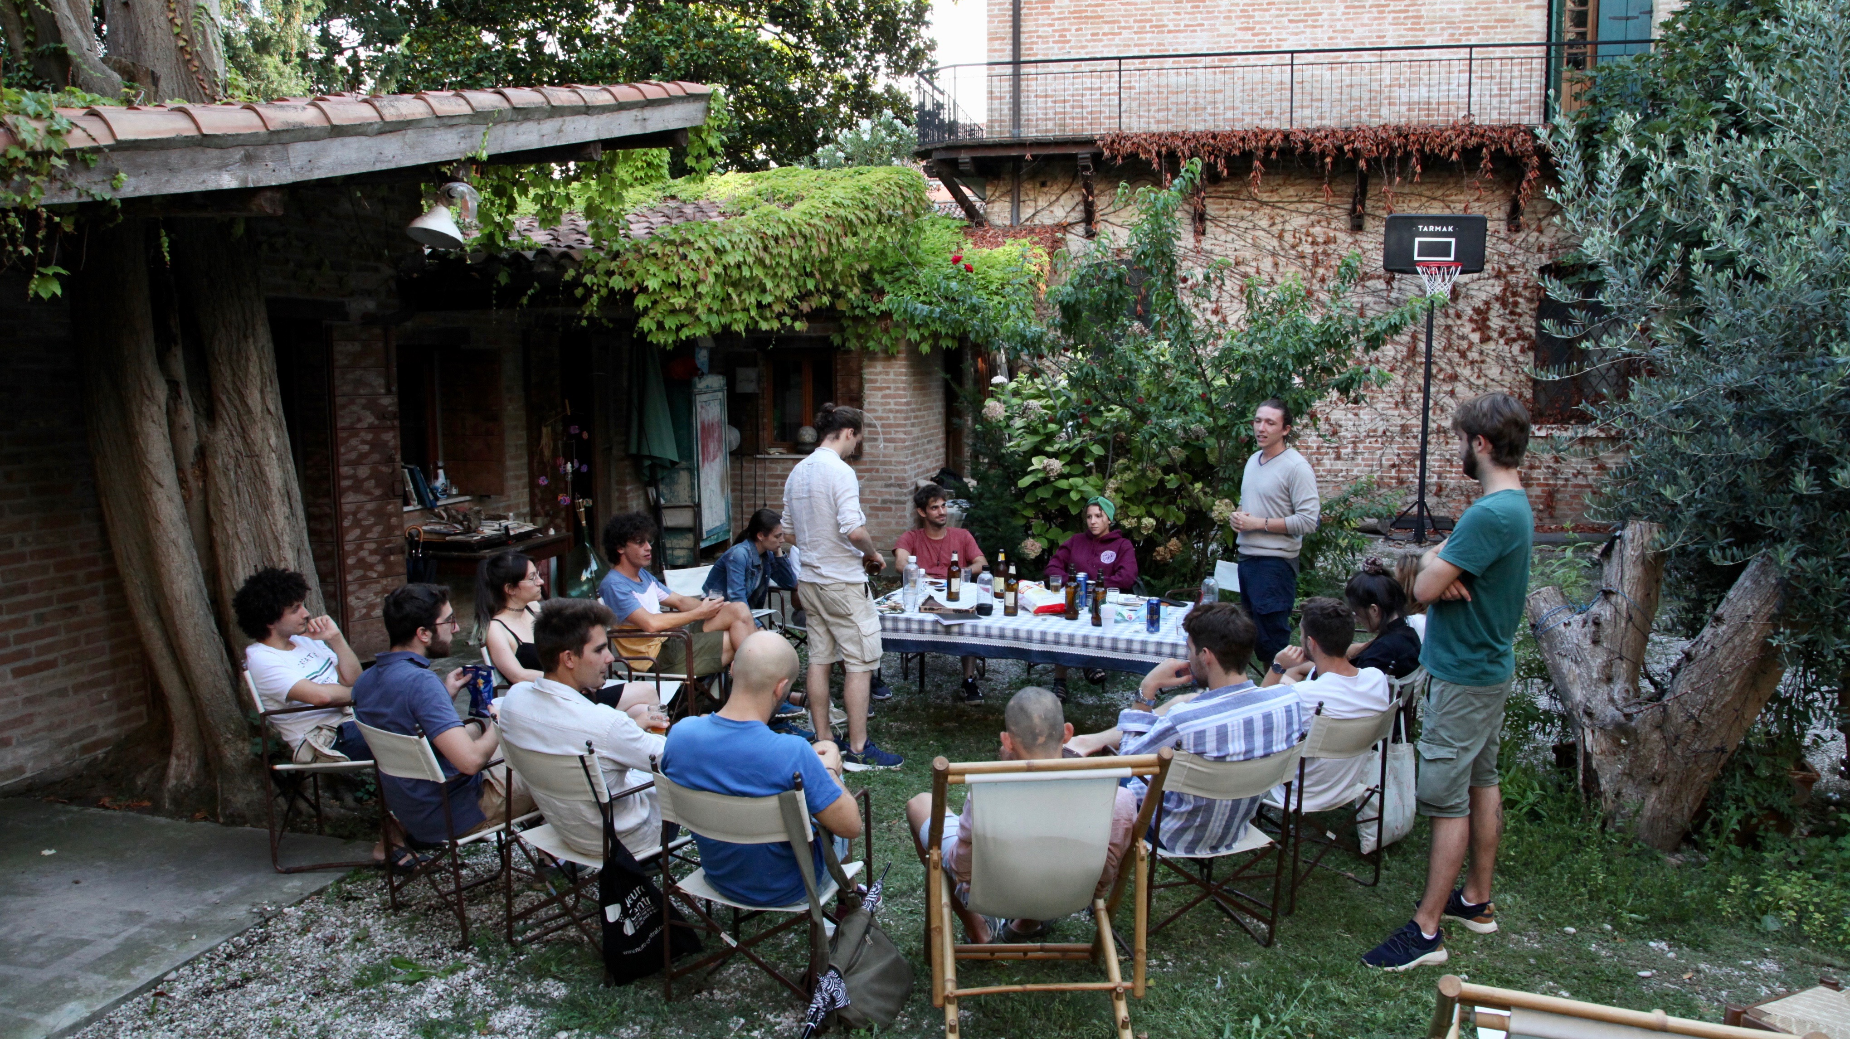

Slide 9
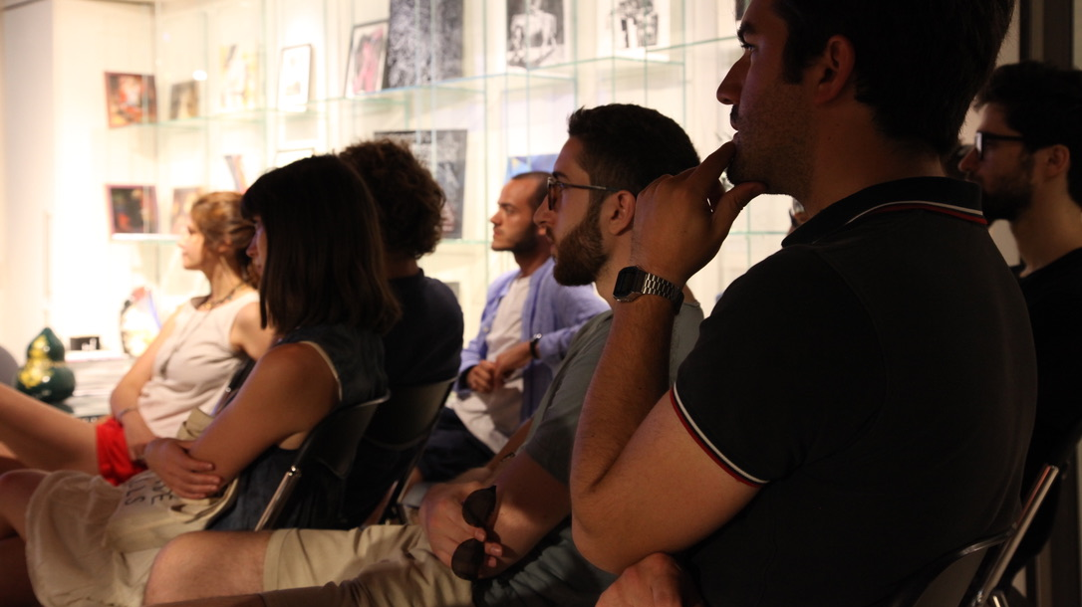

Slide 10
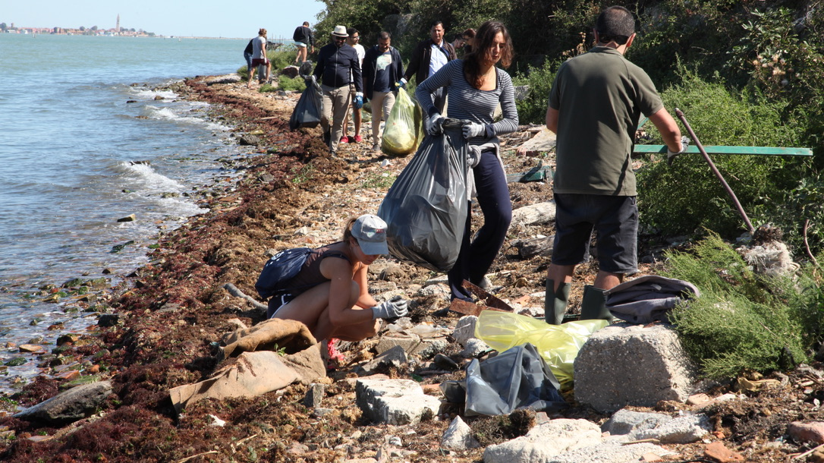

Slide 11
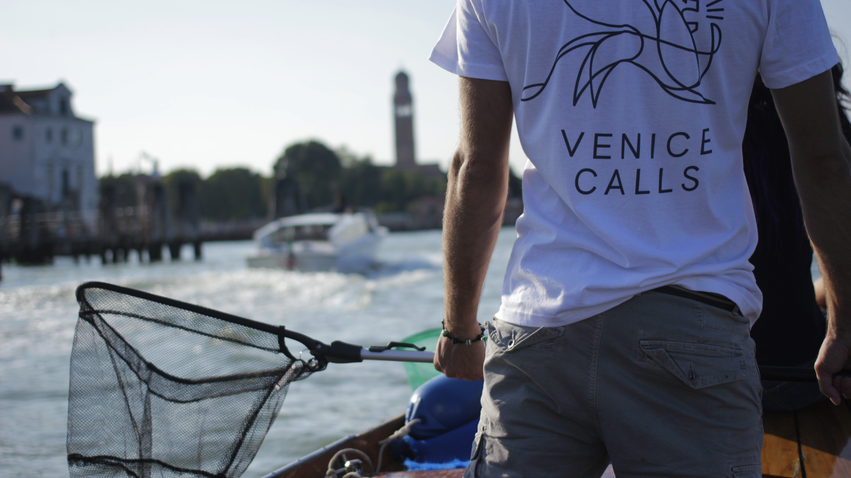

Slide 12
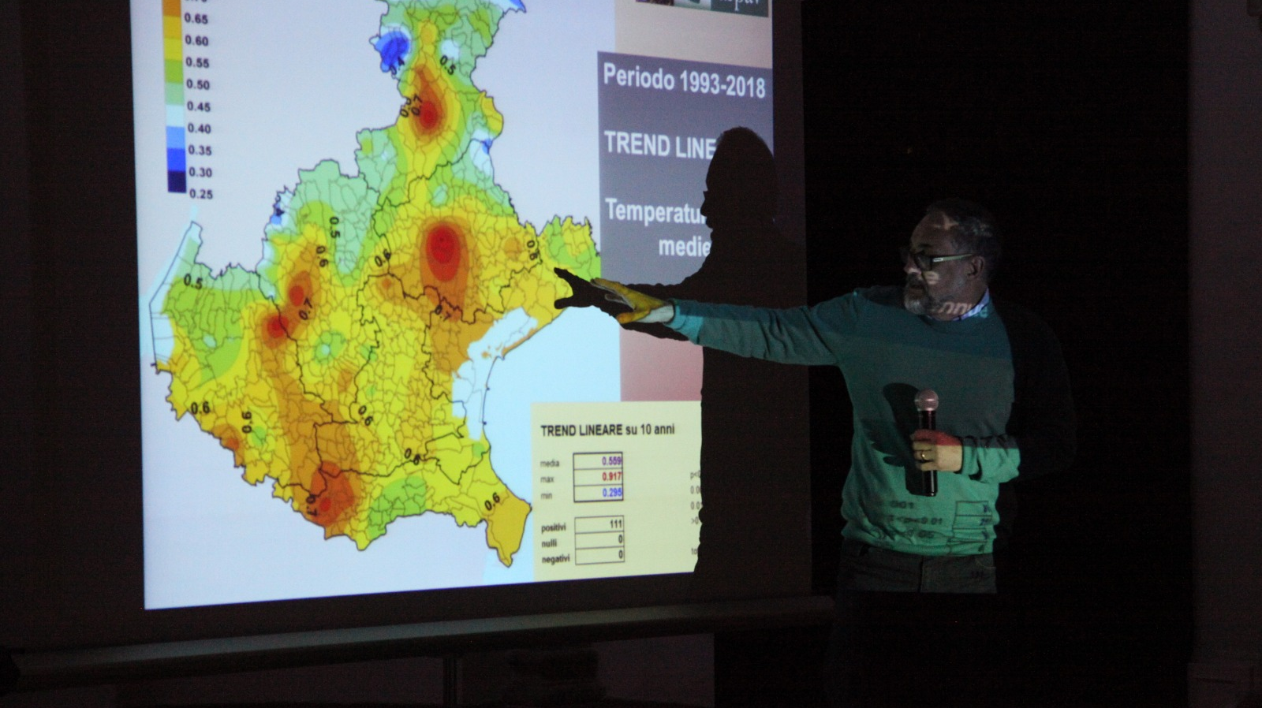

Slide 13
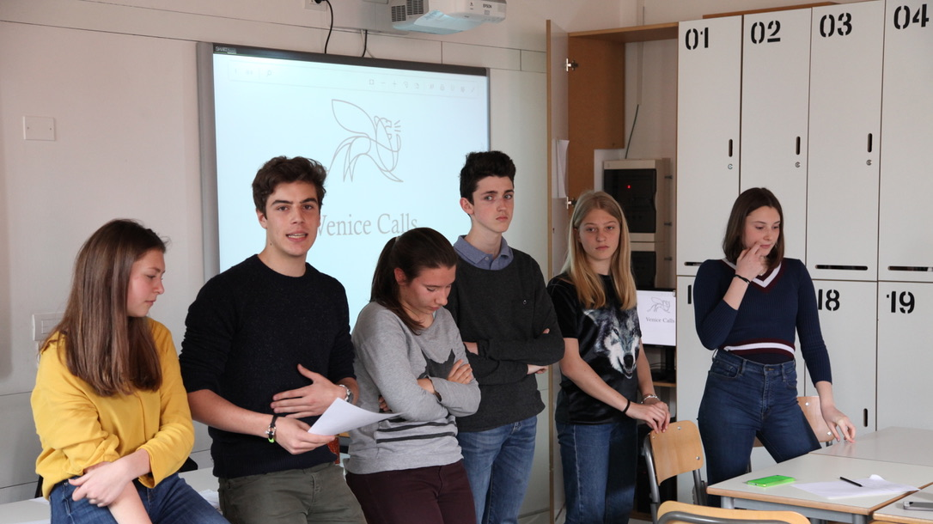

Slide 14
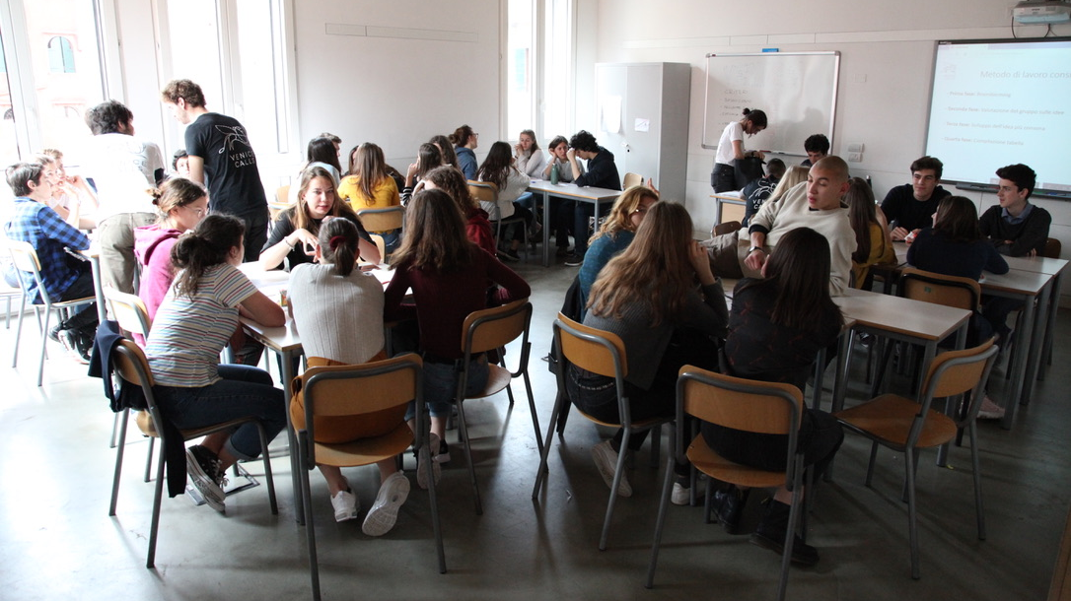

Slide 15
ACQUA ALTA 2019

Slide 16
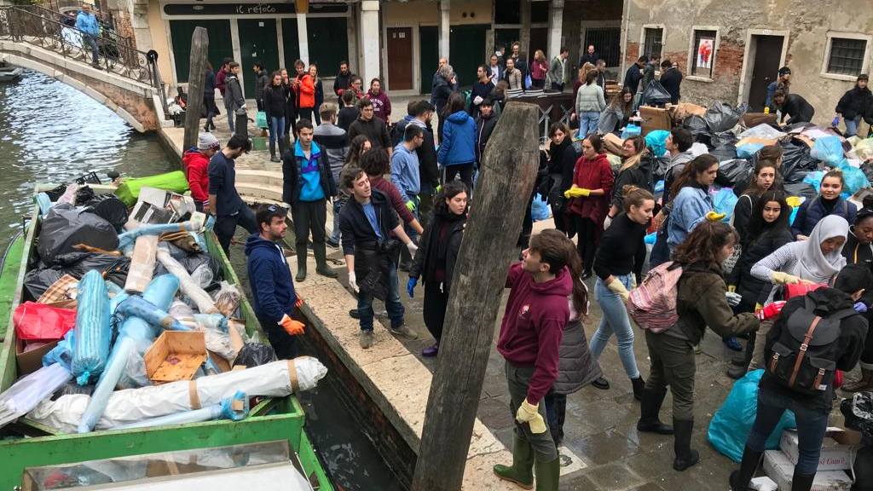
San Zan Degolà

Slide 17
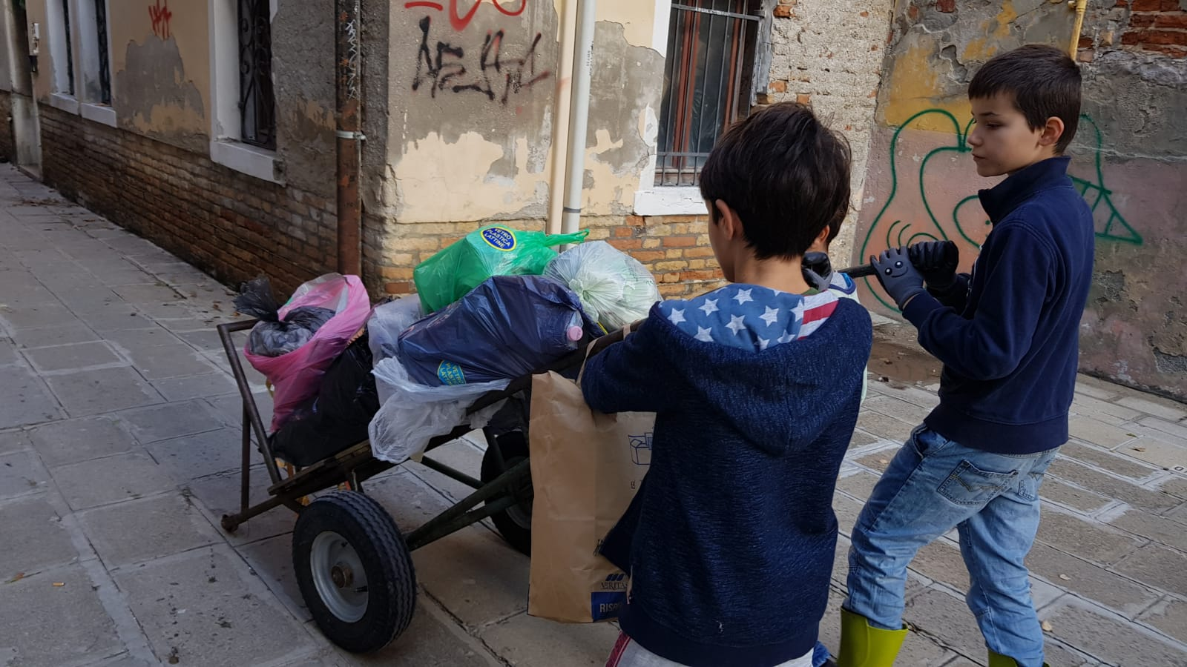

Slide 18
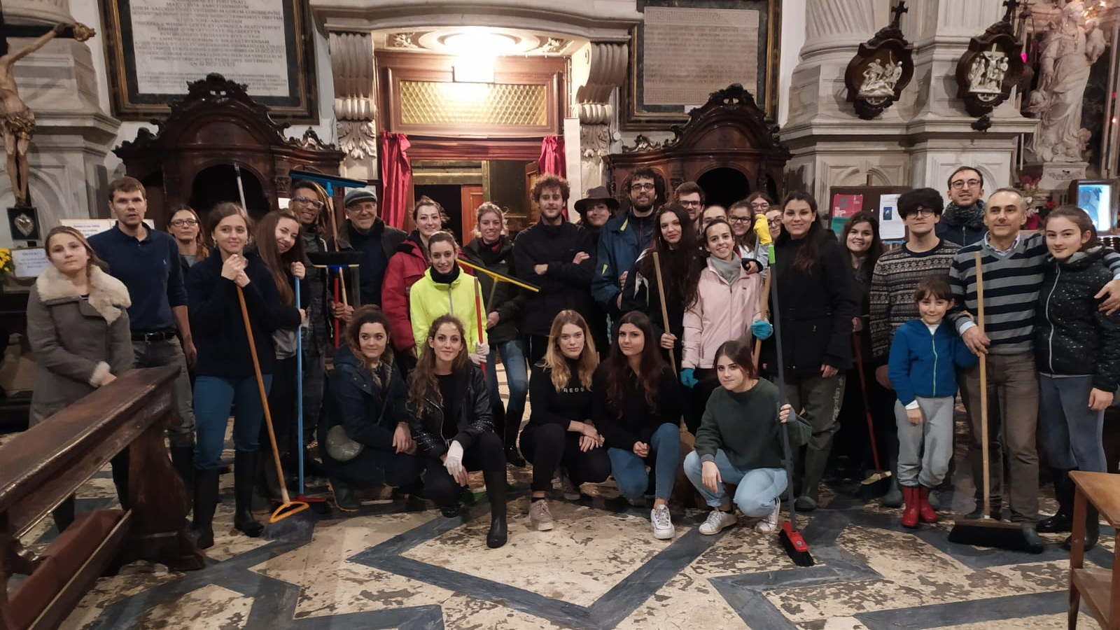

Slide 19
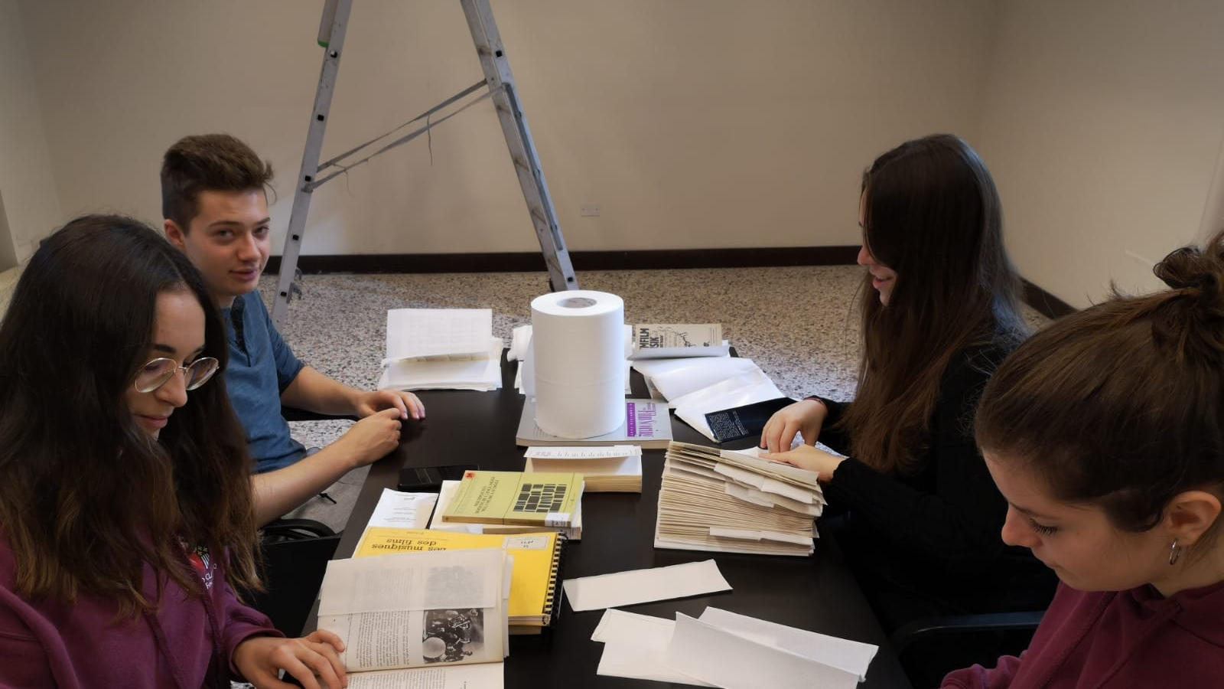
Fondazione Querini Stampalia

Slide 20
Fondazione Querini Stampalia

Slide 21
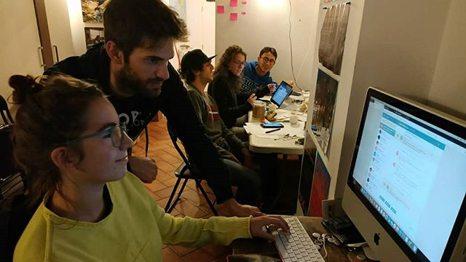
Our headquarters (Dorsoduro)

Slide 22
San Giacomo dell’Orio

Slide 23
San Giacomo dell’Orio

Slide 24
Accademia Bridge

Slide 25
Riva Ca’ di Dio

Slide 26
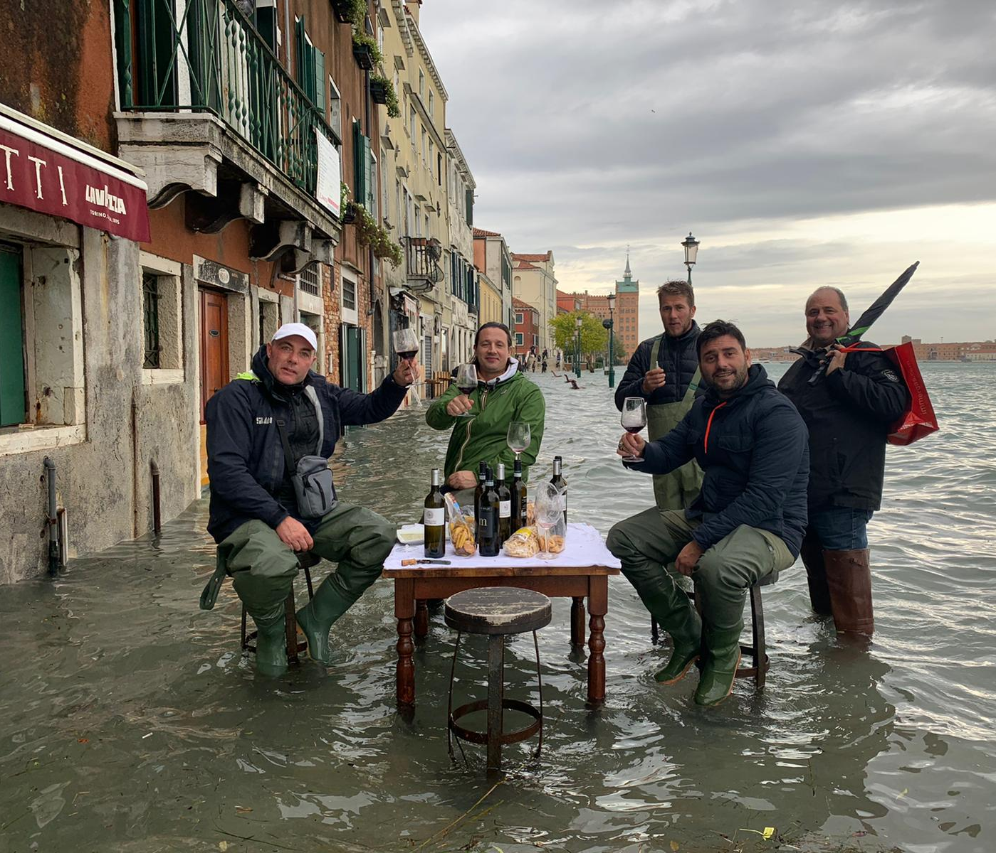
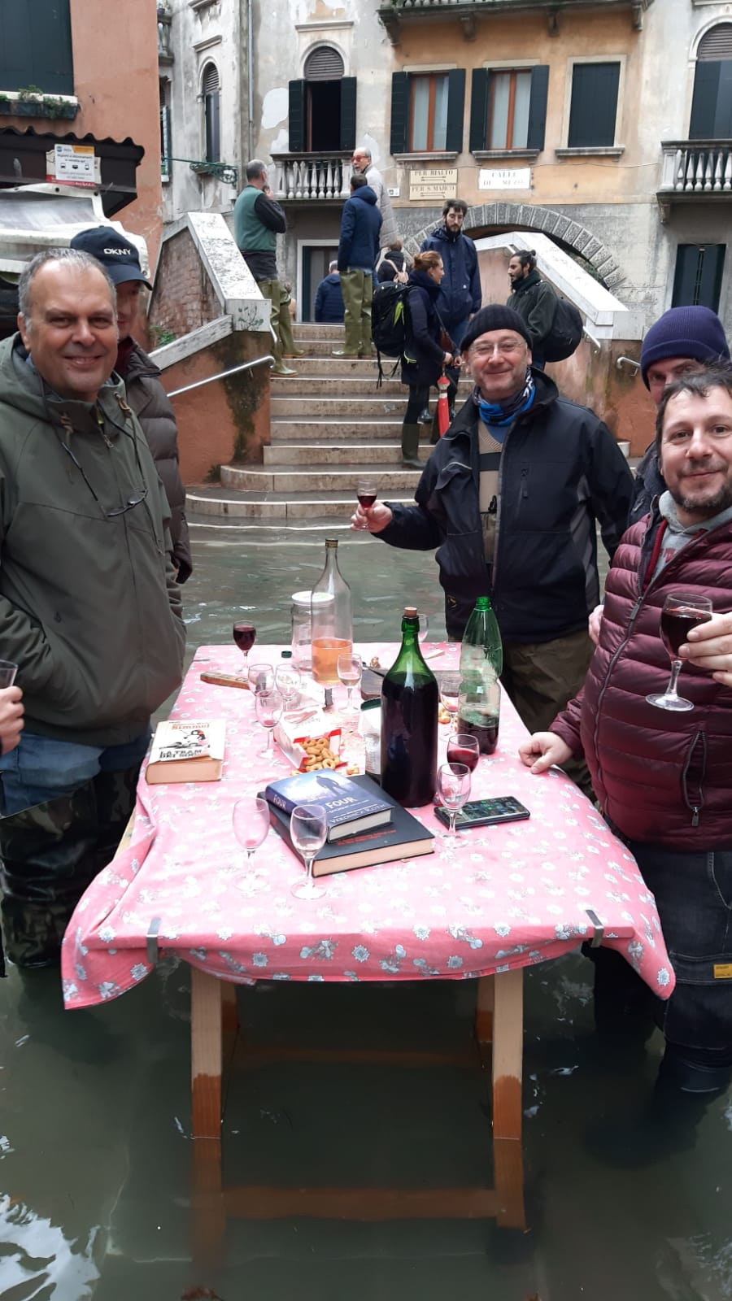
Osteria della Rivetta (Santa Croce)
Ae Botti (Giudecca)

Slide 27
After Acqua Alta

Slide 28
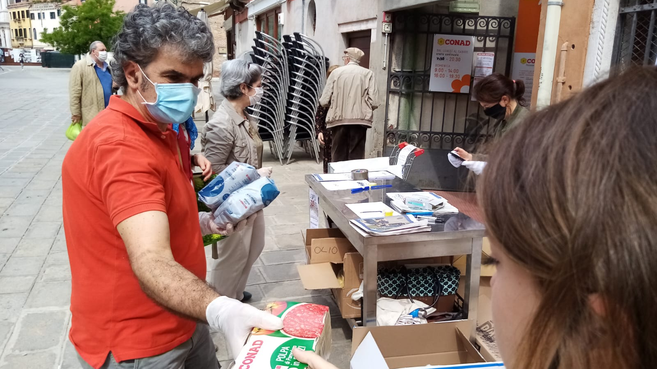

Slide 29
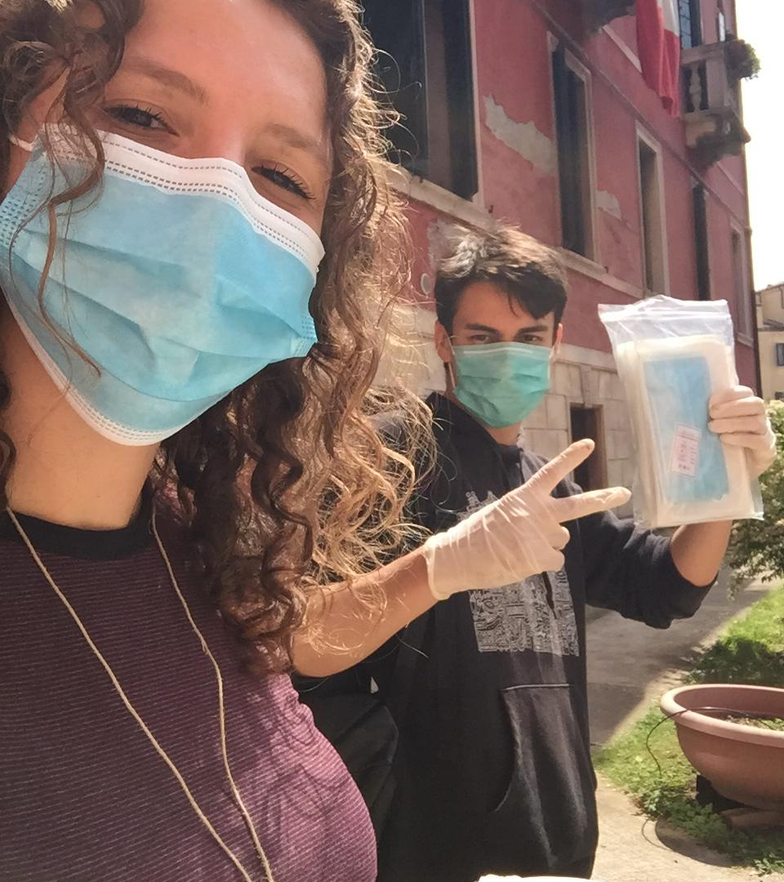
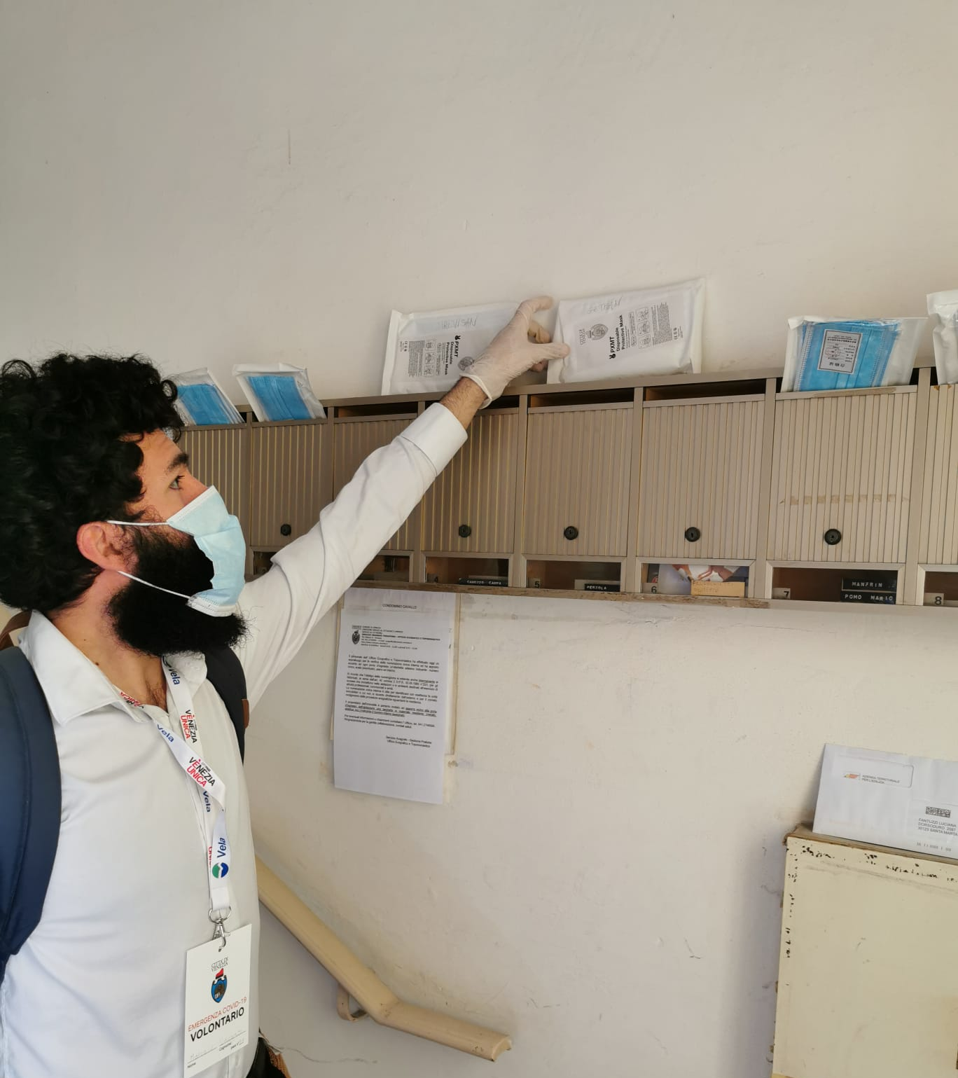

Slide 30
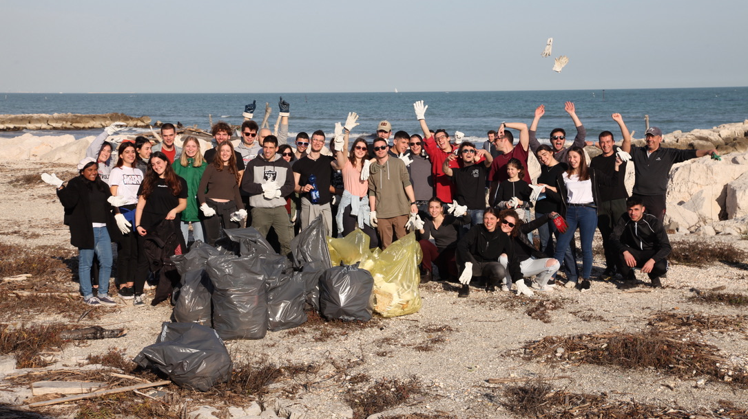

Slide 31
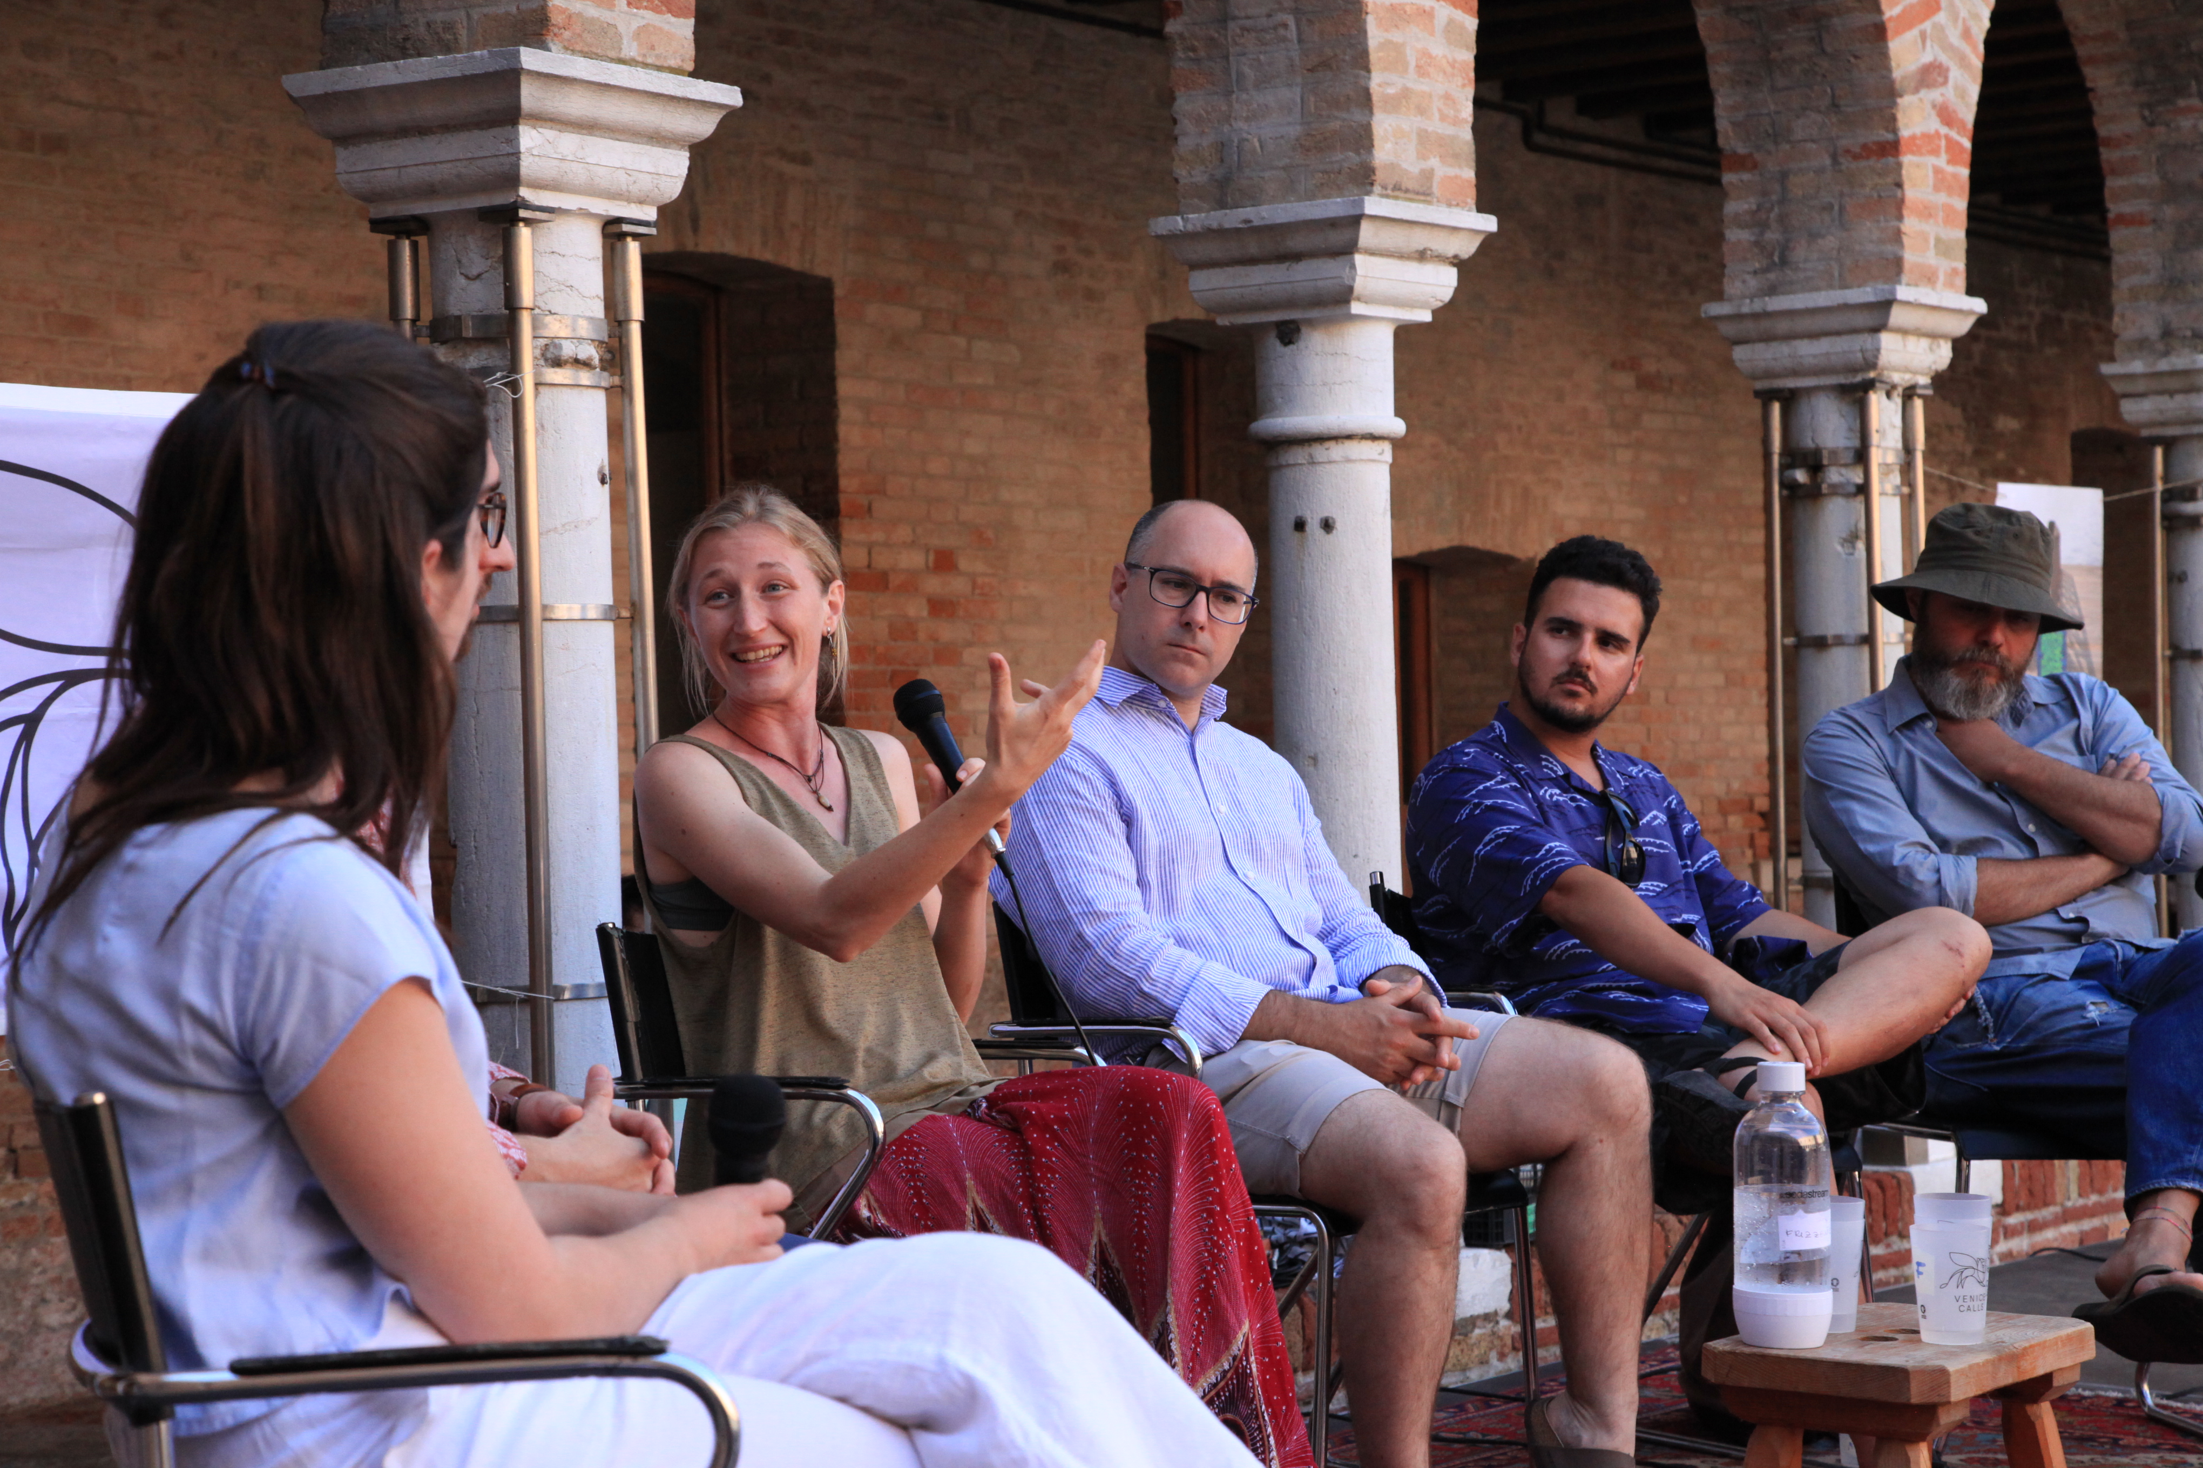

Slide 32
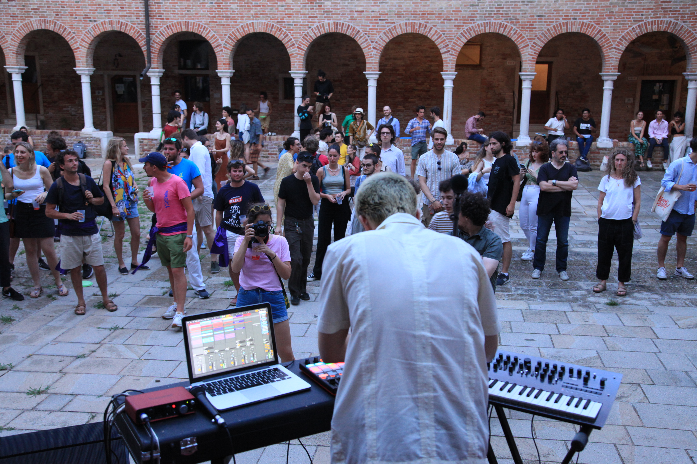

Slide 33
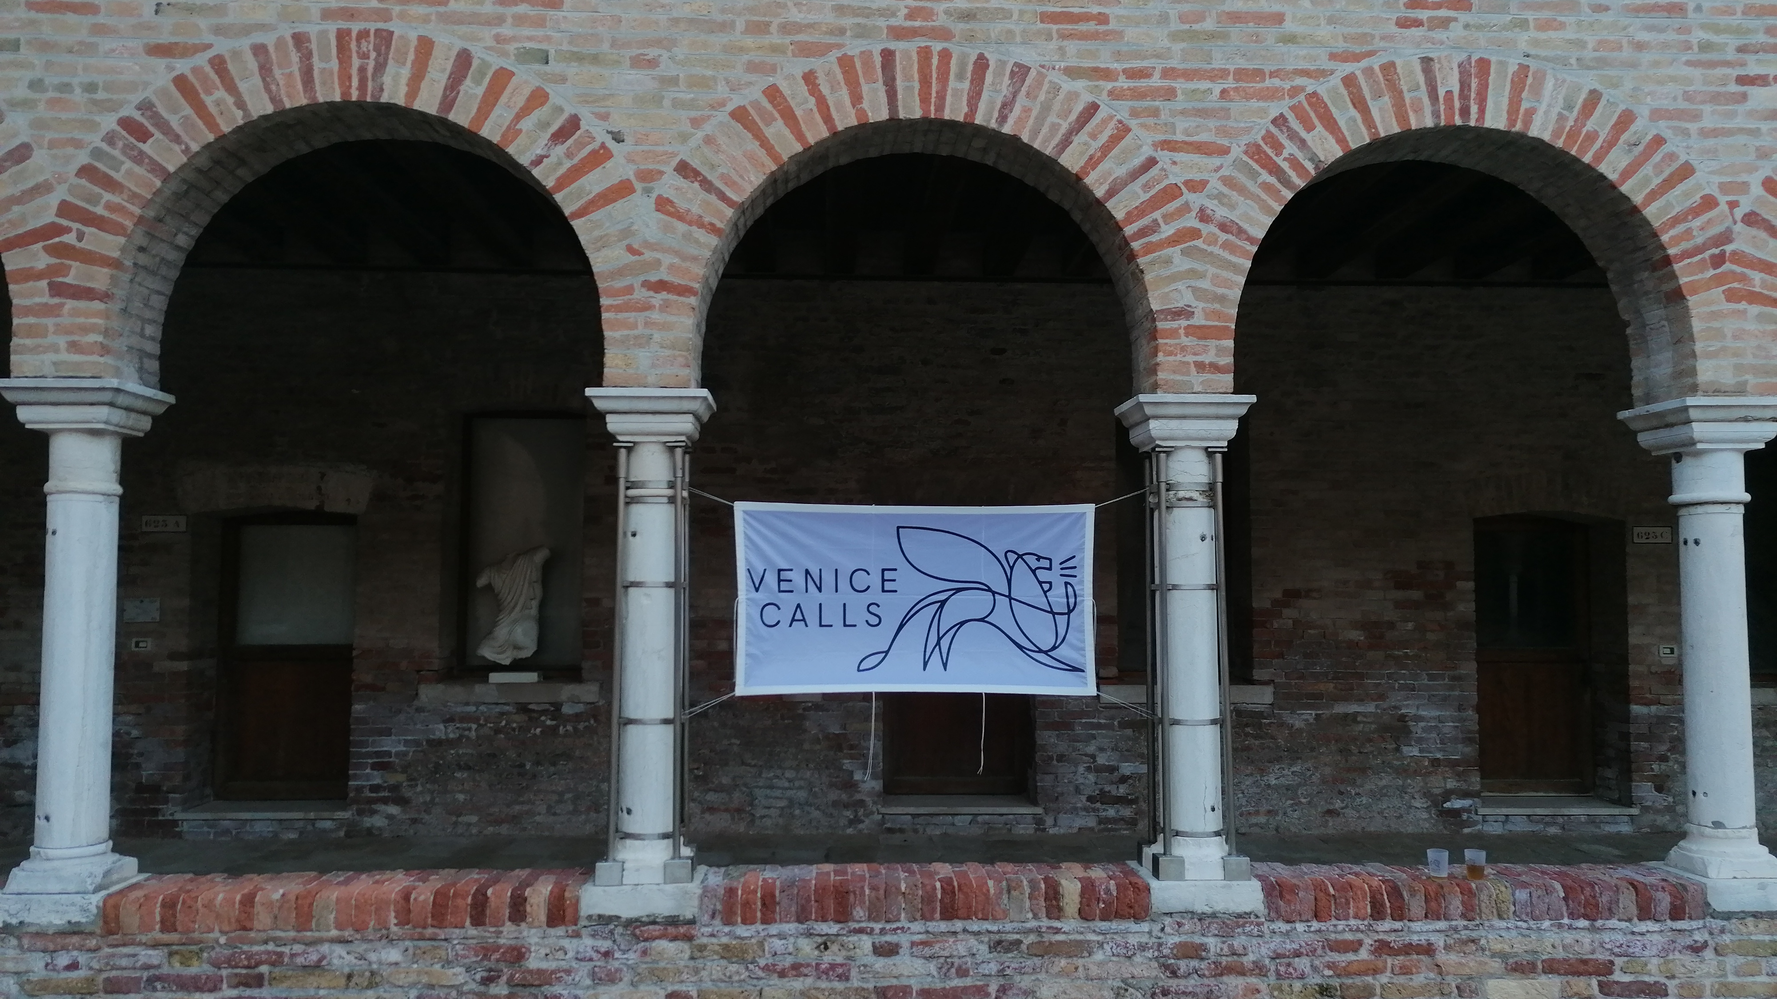

Slide 35
Thank you for your attention
www.venicecalls.com

